Slide 1
TOGG C-SEDAN A-CLASS FRONT DOOR TRIM
Structural Stiffness– RT
July 2023

Slide 2

Disclaimer
TOGG C-SEDAN A-CLASS FRONT DOOR TRIM
DISCLAIMER
This Confidential Presentation (the “Presentation”) has been prepared by Grupo Antolin-Irausa, S.A. (“ANTOLIN”) for information purposes only. The distribution and use by recipients of the information contained herein and any other information provided to the recipient by or on behalf of ANTOLIN or its representatives is strictly confidential, and the recipients bind themselves to strictly limit within their respective organization the circulation, copying and disclosure of the information contained in the Presentation. Except with the expressed consent of ANTOLIN, you may not use, distribute, sell, modify, revise, republish, post or create derivative works (where applicable) of the trademarks, logos, information or other material or content in this Presentation. ANTOLIN has prepared this Presentation with due care based on available information; however, it does not accept any liability whatsoever for the contents or interpretation of the information provided herein. ANTOLIN makes no representation or any other form of assurance as to the accuracy or completeness of the information in this document.
©2023 GRUPO ANTOLIN-IRAUSA, S.A.
All rights reserved

Slide 3
INDEX
01
Global Summary
4
02
CAE Assumptions
03
CAD Data & Materials
5
6
04
Boundary Conditions
05
7
Target Points
X
06
Results Summary
07
8
Results
10
Created by: Sagar Arakh

Slide 4

TOGG Sedan Front Door Trim
TOGG C-SEDAN A-CLASS FRONT DOOR TRIM
BACKGROUND
CAD REFERENCE
CAE MODEL
TEST
TOGG_SEDAN_A_CLASS_FRT_DP_CW25_20230619.hm
810_door_trim_fr_lh_TOGG_C_SEDAN_A_Class_0003.k
Structural Stiffness Simulation
CONCLUSIONS
CONCLUSIONS
PROPOSALS
All Points are OK, when checked against target as displacement or risk of plasticity.

Slide 5
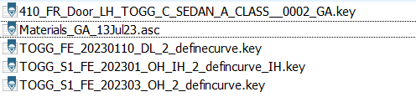
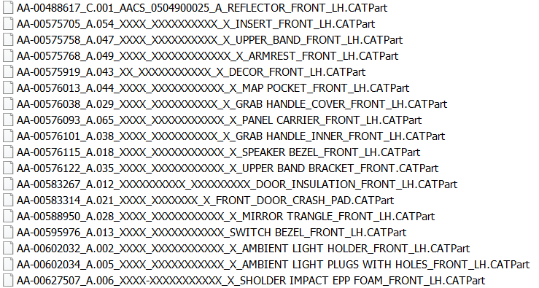
TOGG Sedan Front Door Trim
CAE ASSUMPTIONS
CAD DATA
ENVIROMENT
CAD data released in CW25
MATERIALS
LOAD CASES
Materials assigned as per eBOM_TOGG-SEDAN-HB-FR-cmp_v5.01_20221114_v4_B-Class-3D-data.xlsm
SABIC PP9152C material is replaced by TRC482N material
Pushing_Top_roll_on_the_Door loading
Elbow_Rest_on_Top_Roll loading.
Pushing_Switch_Bezel loading.
Knee_Rest_on_Door_While_Driving loading.
Top_Roll_Peeling loading.
Top_Roll_Pushing loading

Slide 6
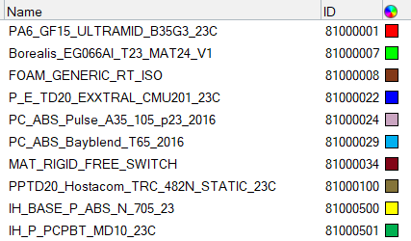
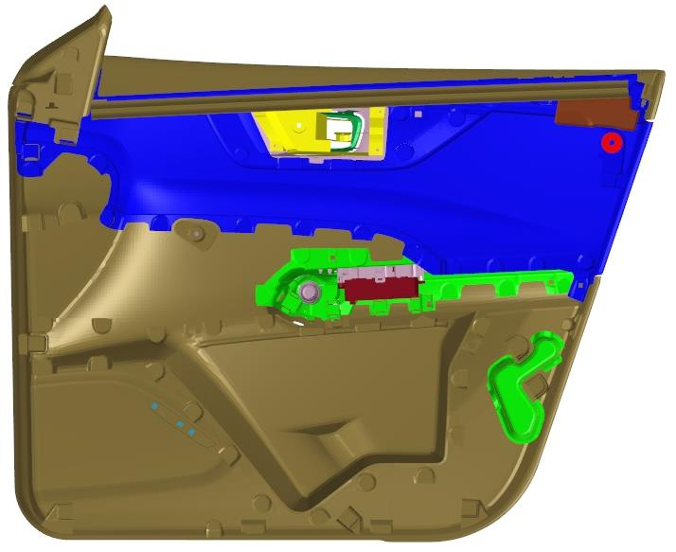
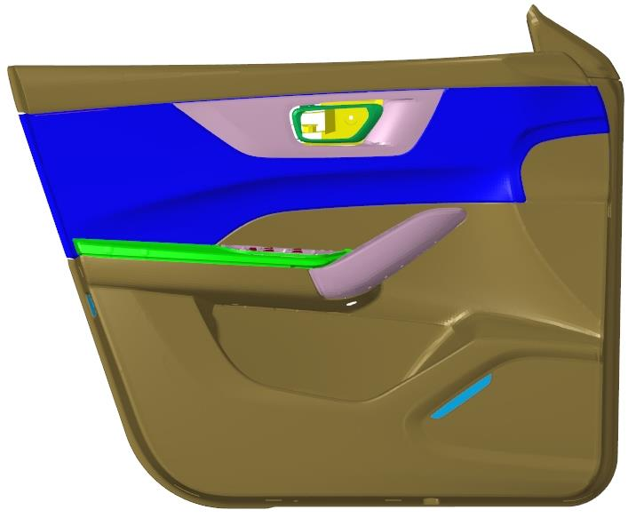
CAD Data & Materials
TOGG C-SEDAN A-CLASS FRONT DOOR TRIM
MATERIALS
MATERIALS

Slide 7
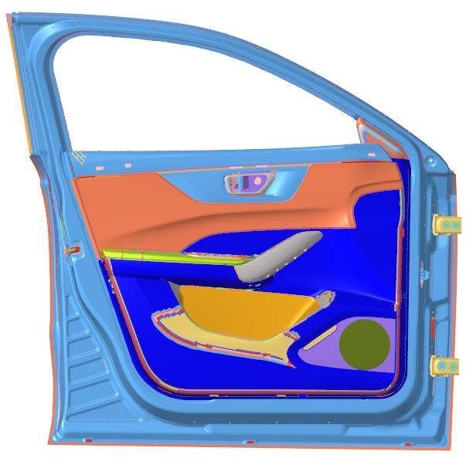
Boundary Conditions
TOGG C-SEDAN A-CLASS FRONT DOOR TRIM
BOUNDARY CONDITIONS
Fixed in all DOF.

Slide 8
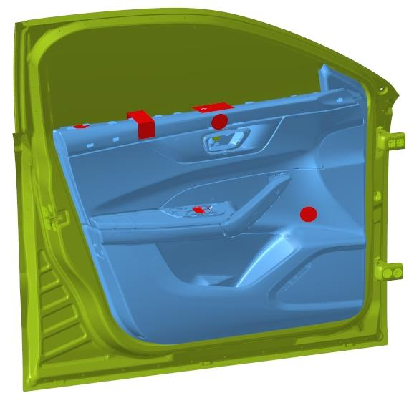
Results Summary
TOGG C-SEDAN A-CLASS FRONT DOOR TRIM
SUMMARY
Test Area | Load Case Positions | Load Case Description | Specimen | Force (N) | Direction | Target Displacement (mm) | Actual Displacement(mm) |  | Target No Permanent deformation/Breakage | Link
 |  |  |  |  |  |  | BA-2 Class | A Class
Front Door Trim | 1 | Pushing Top Roll to Open the Door | 50mm steel Cylinder | 110 | -Y | 4 | 2 | 2.7 | NO
 | 2 | Elbow rest on top roll |  | 67 | -Z | 4 | 0.6 | 0.6 | NO
 | 4 | Pushing Switch Bezel |  | 45 | -Z | 1 (Foam is not considered) | 1 | 1 | NO
 | 5 | Knee rest while driving |  | 22 | -Y | 3 | 0.4 | 0.5 | NO
 | 9 | Top roll Peeling | 50mm Hook | 45 | +Y | 3.5 | 0.6 | 0.5 | NO
 | 10 | Top roll Pushing | 100X100 Rectangular rigid Plate | 500 | -Z | 3.5 | 2.9 | 2.5 | NO
09
10
02
01
04
05
Conclusion
All Points are OK, when checked against target as displacement or risk of plasticity

Slide 9
RESULTS

Slide 10
Load case Details-Pushing Top Roll to Open the Door
TOGG C-SEDAN A-CLASS FRONT DOOR TRIM
COORDINATES
COORDINATES
TEST SETUP

